Slide 1
Sections 9.3/9.4: Hypothesis Testing using P values
https://www.pinterest.com/addicted2abook/data-analysis-humor/

Slide 2
9.3/9.4 Hypothesis tests concerning a population mean when σ is known- Goals
Be able to state the test statistic.
Be able to define, interpret and calculate the P value.
Determine the conclusion of the significance test from the P value and state it in English.
Be able to calculate the power by hand.
Describe the relationships between confidence intervals and hypothesis tests.

Slide 3
Assumptions for Inference
We have an SRS from the population of interest.
The variable we measure has a Normal distribution (or approximately normal distribution) with mean μ and standard deviation σ.
We don’t know μ
but we do know σ (Section 9.3)
We do not know σ (Section 9.5)
σ

Slide 4
Test Statistic
A test statistic, TS, calculated from the sample data measures how far the data diverge from what we would expect if the null hypothesis H₀ were true.
$$z_{ts}=\frac{estimate−hypothesized value}{standard deviation of the estimate}$$
$$=\frac{\overline{x}−μ_{0}}{σ/{\sqrt{n}}}$$
Large values of the statistic show that the data are not consistent with H₀.

Slide 5
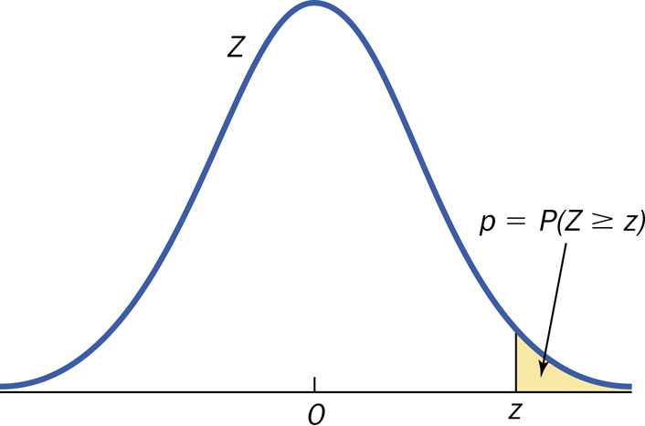
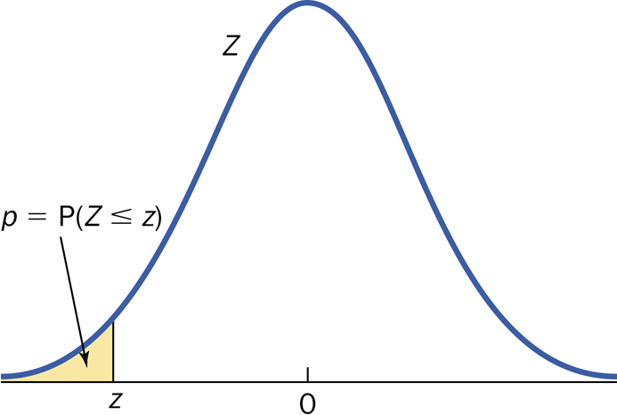
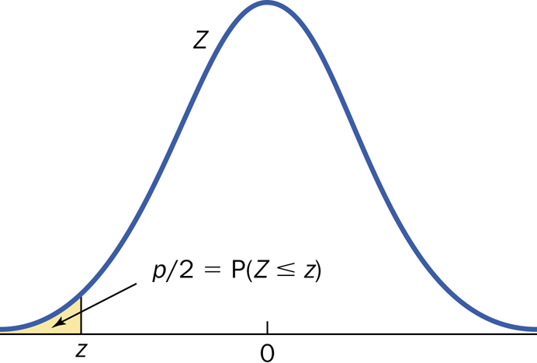
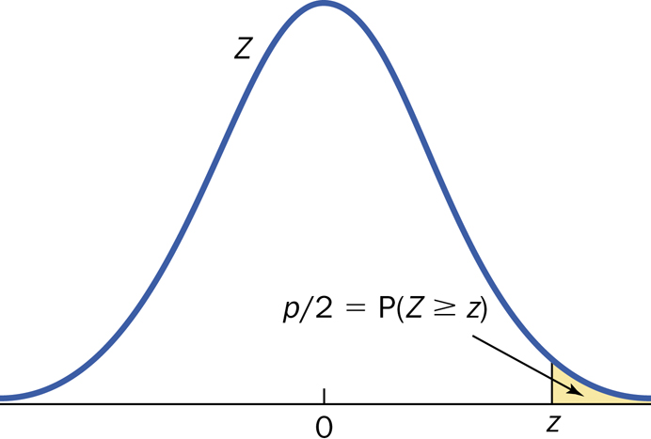
P-value
Right Tailed
Left Tailed
Two Tailed
z_{ts} < 0
z_{ts} > 0

Slide 6
P-value (cont)
The p-value for a hypothesis test is the smallest significance level for which the null hypothesis, H₀, can be rejected.
The probability, computed assuming H₀ is true, that the statistic would take a value as or more extreme than the one actually observed is called the p-value of the test. The smaller the P-value, the stronger the evidence against H₀.

Slide 7
P-value (cont.)
Small P-values are evidence against H₀ because they say that the observed result is unlikely to occur when H₀ is true.
Large P-values fail to give convincing evidence against H₀ because they say that the observed result is likely to occur by chance when H₀ is true.

Slide 8
P-value
Right Tailed
Left Tailed
Two Tailed
z_{ts} < 0
z_{ts} > 0

Slide 9
Significance
α measures the strength of the sample evidence against H₀.
The power measures the sensitivity (true negative) of the test.

Slide 10
Statistically Significant - Comments
Significance is a technical term
Determine what significance level (α) you want BEFORE the data is analyzed.
Conclusion
P-value ≤ α --> reject H₀
P-value > α --> fail to reject H₀

Slide 11
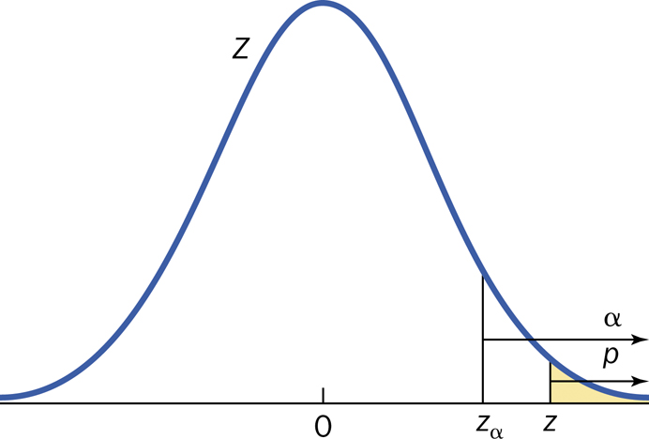
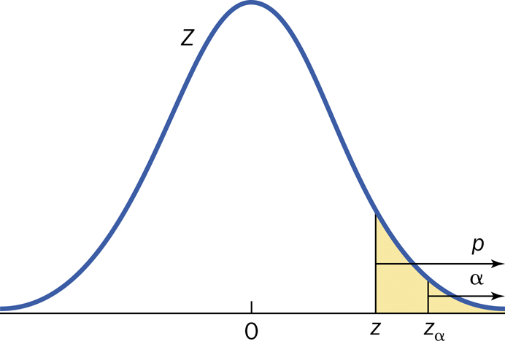
P-value
Reject H₀
Fail to reject H₀

Slide 12
P-value interpretation
The probability, computed assuming H₀ is true, that the statistic would take a value as or more extreme than the one actually observed is called the P-value of the test.
The P-value (or observed significance level) is the smallest level of significance at which H₀ would be rejected when a specified test procedure is used on a given data set.
The P-value is NOT the probability that H₀ is true.

Slide 13
Procedure for Hypothesis Testing
1. Identify the parameter(s) of interest and describe it (them) in the context of the problem.
2. State the Hypotheses.
3. Calculate the appropriate test statistic and find the P-value.
4. Make the decision (with reason) and state the conclusion in the problem context.
Reject H₀ or fail to reject H₀ and why.
The data [does or might] [not] give [strong] support (P-value = [value]) to the claim that the [statement of H_{a} in words].

Slide 14
Single mean test: Summary
Null hypothesis: H₀: μ = μ₀
Test statistic:
 | Alternative Hypothesis | P-Value
One-sided: upper-tailed | H_{a}: μ > μ₀ | P(Z ≥ z)
One-sided: lower-tailed | H_{a}: μ < μ₀ | P(Z ≤ z)
two-sided | H_{a}: μ ≠ μ₀ | 2P(Z ≥ |z|)

Slide 15
Calculation of β and Power
Procedure is like Example 9.10 (Section 9.3).
Determine the cutoff by using the given value of α.
P(Type I Error) = P(reject H₀|H₀ is true)
Calculate β given the true value of the mean.
P(Type II Error) = P(fail to reject H₀|H₀ is false).
OR
Calculate Power given the true value of the mean.
Power = P(reject H₀|H₀ is false)

Slide 16
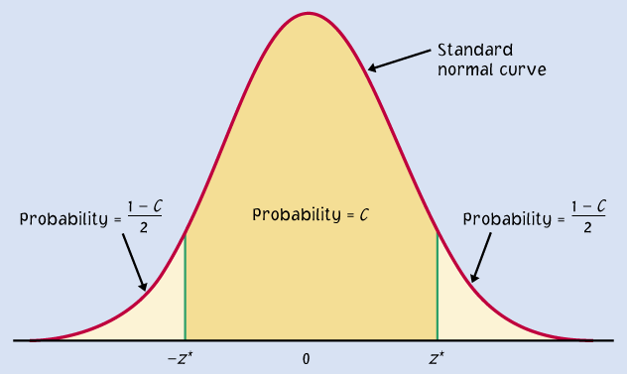
CI and HT

Slide 17
Confidence interval vs. Hypothesis Test
Confidence Interval | Hypothesis Test
Range of values at one confidence level. | Yes or no with a measure of how close you are to the cutoff.

